Slide 1
Raja Shree Shivray Pratishan’s
Maharashtra College Of Science and Commerce
Kothrud, Pune :- 38
Student Name :- Shete Akshay Pradip
Roll No :- 525
Project Name :- Testing Fundamentals
Company Name :- Vimik Solutions Pvt Ltd.
Guidence :- Prof. Mrs. Vidya Dole
Testing Fundamentals

Slide 2
SCOPE OF THE PROJECT :-
Testing Fundamentals covers all the topics related to testing so the end user or document reader can get an easy idea about Testing Concepts and its fundamentals.
Our aim is to give an detailed idea and information about each and every part of testing from basics to advance. So anyone become expert in Testing Environment.
It covers every topic, definition of testing and its types. As well as it contains information about Test Data, Test Cases, Test Scripts etc.
It has wide scope and best for a new comer.

Slide 3
What Is Testing :-
Software Testing is a program conducted to provide information to the stakeholders, clients and the people associated with it with the information about the quality of software product or service under test known as Application Under Test (AUT).
It mainly include various parts of testing an application through functionally and non-functionally. Testing help us to meet following criteria under AUT.
It should meets the requirement that guided its design and development.
Responds correctly to all kind of inputs as well as performs its function within an acceptable time.
It is sufficiently usable and must achieve the general result its stakeholders and clients desire.
Testing also help us to check the quality of software developed.

Slide 4
Characteristics Of Software Requirement
Unambiguous
Complete
Testable
Non-Redundant
A good requirement should be stated in such a way that multiple readers must interpret the same meaning out of it.
Software requirements must contain all the significant needs and conditions expected from the system relating to the functionality, performance etc. It must specify the responses of the system to all varieties of data.
Software requirements is said to be testable if there exists some finite and cost effective process that enables a tester to check if this requirement is met in the software.
Software requirement must be stated in such a way that it clearly points to one behavior or functionality of a system. If more than one requirement points to the same behavior or functionality, then these requirement become redundant.

Slide 5
BLACK BOX TESTING
ADVANTAGES | DISADVANTAGES
Well suited and efficient for large code segments. | Limited Coverage.
Code access not required. | Inefficient testing.
Clearly separates user’s perspective from the developer’s perspective through visibility defined roles. | Bind Coverage.
Moderately skilled testers required. | The test cases are difficult to design.
Static Testing | Dynamic Testing
Testing done without executing the program. | Testing done by executing the program.
Testing does verification process. | Dynamic testing does validation process.
Static testing is about prevention of defects. | Dynamic testing is about finding and fixing the defects.
This testing can be performed before compilation. | It is performed after compilation.
Static testing involves checklist. | It involves test cases for execution.
Cost of finding defects and fixing defect is less. | Cost of finding and fixing the defect is high.
More reviews comments are highly recommended for good quality. | More defects are highly recommended for good quality.
ADVANTAGES | DISADVANTAGES
It helps in optimising the code. | Sometime it is not possible to look into every nook and corner to find out errors.
Extra lines of codes can be removed. | It is difficult to maintain white box testing as code analysers and debuggers tools are required which is available at high cost.
As the tester has knowledge of the source code it become very easy to find out which type of test data required and suite the application. | Due to the fact that a skilled tester is needed to perform white box testing the cost is increased.
WHITE BOX TESTING

Slide 6
Different Types Of Testing
Unit
Integration
Functional
System
Smoke
Sanity
Regression
Acceptance
Performance
Unit testing is done by developers. It comes under white box testing. It involves development of stubs and drivers. The purpose of unit testing is to separate each part of the program and verify proper functionality of individual modules based on requirements.
Functional testing is performed on a complete and integrated system to ensure that the specified functionality required in the system works. It comes under black box testing and focuses on testing the application against use cases, design documents and SRS. It test the functionality of each and every section of an application.
System testing is performed on a completed integrated system. It comes under black box testing. It is implemented by the dedicated testing team which ensures that the application meets the functional and technical specification along with quality standards. The test environment is quite similar to production environment where the application is supposed to be deployed.
Smoke testing is performed on a initial build of a software to make sure that the crucial functionalities of the software are working fine. The main objective is to ensure that major functionalities are working and the build is stable enough to continue with through functional testing.
Sanity testing is performed to ensure that the defects have been fixed and no further defects have been introduced due to minor changes in the code or functionality. It is a subset of regression testing. Both smoke and sanity testing help to detect the defects at an early stage to save time and cost involves in rigorous testing.
Regression testing mainly focuses on detecting such defects in an application and ensures that enhancement in application is functioning properly. It provides consistent and repetitive validation of every new product release. Methods include re-running previously executed tests. Automated execution of tests is preferred in regression testing.
Integration testing tests the functionality of various modules of an application combined together. It is especially applicable to client/server and distributed systems. It also test the interaction between software and hardware. It comes under both white box testing and black box testing. Integration testing helps to expose defects in the interfaces.

Slide 7
Requirement analysis is the most significant stage in STLC. During this phase the Quality Assurance (QA) team tries to understand the requirements from testing point of view and identify the testable requirement.
The QA team interacts with various stakeholders like Business Analyst, Development Team, Client, Technical Leads, System Architects, etc. to understand the requirements of the system in detail.
The QA team also analyses the feasibility for test automation in this phase.
Manual Testing Lifecycle:-
Requirement Capture and Analysis
In this phase the QA Manager makes the strategy for the complete testing process. The cost and effort required are estimated for the project. The Test Plan is designed which specifies the scope, approach, resources and schedule of all testing activities. The plan includes the features to be tested the various types of testing to be performed, the roles and responsibilities for personnel involved, the resources and schedule required to complete testing.
Test Planning and Design
During this phase the test team tests readiness of environment which was set up in the test design phase. The testers also execute the test cases as per the test plan. The defects are reported back to the development team. Once the defects are fixed, the system is tested again to ensure that the software is defect free and ready to be deployed at the client side.
Test Execution Reports, Defect Report are the important aspects of Test Execution.
Test Execution
Test Cycle Closure
This is the last phase of testing cycle. In this phase the testing process used for the project is evaluated and lessons learnt from the process are documented. The main focus here is to identify the best process can be implemented in the future.
Project Learning Documents, Case Study, Metrics Report are the most important aspects of Test Closure.
Test Closure

Slide 8
Test Case Preparation :-
Test cases are the scenarios which are used to test functionality of an application or a software step by step. It describes the information about scenario which is helpful to test an application.
There are various ways to write test cases. Test cases should be unambiguous, complete, non-redundant so the tester should be easily understand and execute the test case.
BRD No | TC Name | Test Case Description | Precondition | Step 1 | Expected Result | Step 2 | Expected Result | Step 3 | Expected Result
CR-745 | CR745_TC_01 | This test case is use to check Login-functionality of an application. | User should have access to an application. | Enter valid Username and Password. Click on Submit. | User should be login succesfully and navigate to the main page. | User should be able to see Last Login Time. | Last Login time should be display automatically on screen. | Click on Logout Button. | User should be logout succesfully from an application.
CR-745 | CR745-TC-02 | New Customer Id should be created after entering valid customer details. | i) User should have application access. ii) Valid customer details available. | Click on New Customer Button and enter valid details of customer. | Details should be entered successfully. | Click on submit button and then Customer ID populated | Valid Customer ID should be populated which is able to use for further process | Click on Logout Button. | User should be Logout from an application successfully.

Slide 9
Different Type of Test Data
Static
Master
Configurable
Transactional
Parameters that drive the application or the system.
Ex:- License details, Server Details, User Credentials.
Static Data is a data which never changes throughout the application. It remains constant.
Ex :- Gender of a person.
Based on the business transactions like AUT.
Ex:- Order ID, Payment reference etc.
These are data that are rarely updated but often read.
Ex:- Customer information like Name, Email, Mobile No etc.

Slide 10
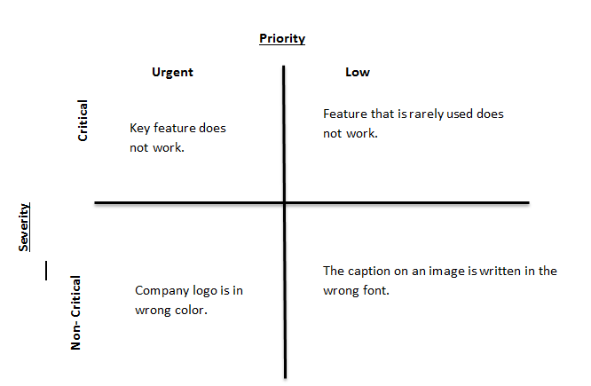
Software Defect :-
A software defect is an error or fault in the software that leads to an unexpected behaviour of the system. The defect could be caused by reasons like a miscommunication of requirement, poor coding skills, time pressure etc.
The software defects are categorized based on :-
Severity :- It is the extent to which a defect can affect the software.
Priority :- The urgency with which the defect should be addressed.

Slide 11
Defect Status
New
Assigned
Open
Fixed
Retest
Deferred
Duplicate
Rejected
Reopen
Closed
The tester rechecks the code and the system to check if the defect has been removed.
If the defect does not exist in the software anymore then the tester closes the defect.
A defect has been logged for the first time.
The developer has started analyzing and working on the defect.
The defect has been assigned to the development team for fix.
The developer makes code changes in order to rectify the defect.
If two defects refer to the same concept then it is considered as duplicate.
If the defect is not fixed and tester post the defect again.
When the defect is expected to be fixed in the upcoming releases then the status is changed to deferred. Some of the other factors are low priority of the defect or lack of time for the release or low severity.
If the defect posted by the tester is not genuine, the developer reject the defect.

Slide 12
How To Raise Software Defect :-
We are working on a bank module where we have to create Customer ID after filling all customer details. We have to perform following test case.
BRD No | TC Name | Test Case Description | Precondition | Step 1 | Expected Result | Step 2 | Expected Result | Step 3 | Expected Result
CR-745 | CR745-TC-02 | New Customer Id should be created after entering valid customer details. | i) User should have application access. ii) Valid customer details available. | Click on New Customer Button and enter valid details of customer. | Details should be entered succesfully. | Click on submit button and then Customer ID populated | Valid Customer ID should be populated which is able to use for further process | Click on Logout Button. | User should be Logout from an application successfully.
But while creating new customer, Application not able to populate new Customer ID for that customer. So we raised the defect as follows :-

Slide 13
Defect Description :-
CR 745 | Customer Module | ST | Customer ID not populated after entering valid customer details.
Steps To Reproduce :-
Login into application.
Click on New Customer button.
Enter all the required customer details and click on submit button.
Expected Result :-
Customer ID should be automatically populated for a new customer.
Actual Result :-
Customer ID is not populating automatically for a new customer.

Slide 14
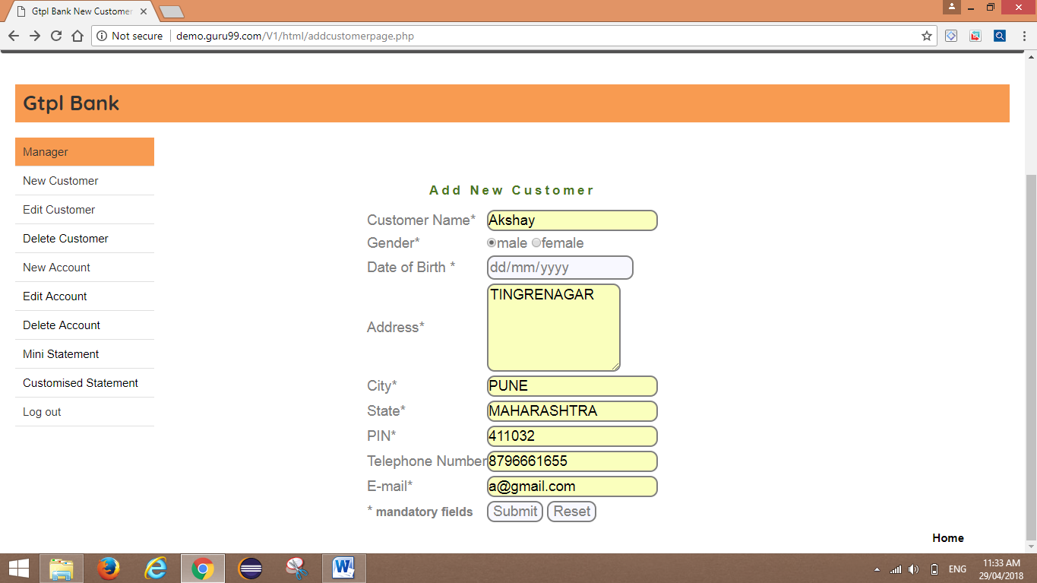
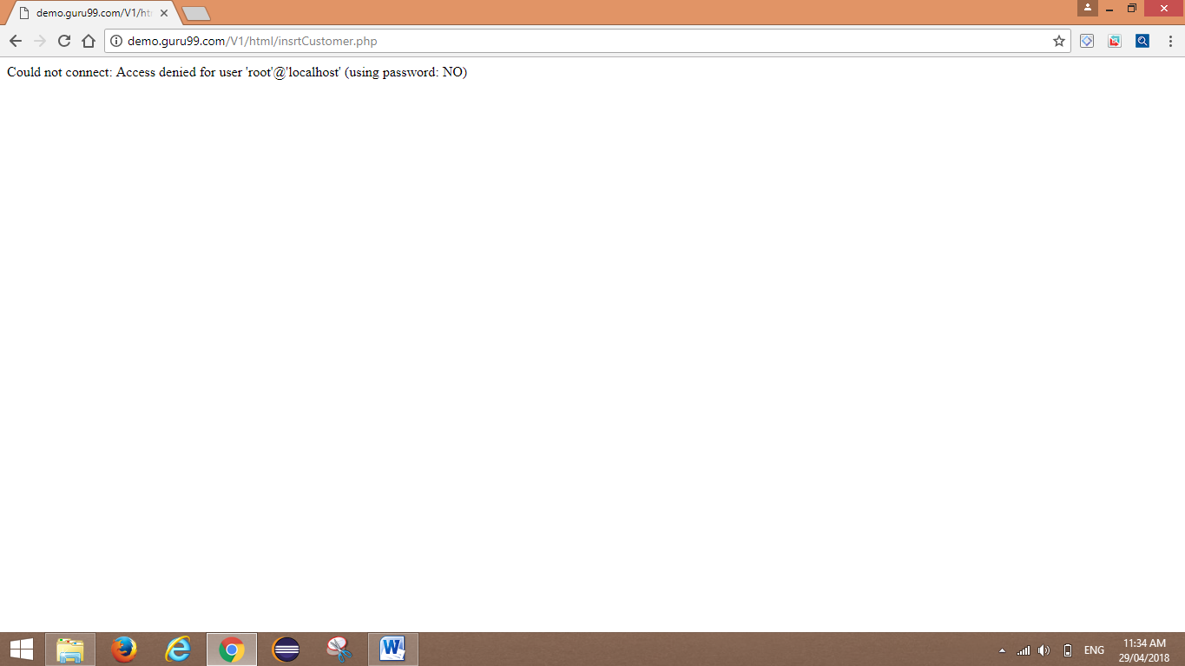
Evidences for Defect :-
Defect ID should be automatically created after raising a defect. For Ex:- Defect 1234.

Slide 15
ADVANTAGES OF MANUAL TESTING | DISADVANTAGES OF MANUAL TESTING
Applications that have constantly changes. | GUI objects size difference and colour combination etc. is not easy to find out in manual testing.
It requires less time and expense to begin productive manual testing. | Load testing and performance testing is not possible in manual testing.
Automation cannot replace human intuition, inference, and inductive reasoning. | Running test manually is very time consuming job.
Automation testing cannot change course in the middle of a test run to examine something that had not been previously considered. | Regression Test cases are time consuming if it is manual testing.

Slide 16
Automation Testing :-
Automation testing is a technique uses an application to implement entire life cycle of the software in less time and provides efficiency and effectiveness to the testing software.
Automation testing is an Automatic technique where the tester writes scripts by own and uses suitable software to test the software. It is basically an automation process of a manual process. Like regression testing, Automation testing also used to test the application from load, performance and stress point of view.
In other word, Automation testing uses automation tools to write and execute test cases, no manual involvement is required while executing an automated test suite. Usually, testers write test scripts and test cases using the automation tool and then group into test suites.
The main goal of Automation testing is to increase the test efficiency and develop software value.
Automation Testing Beats Manual Testing :-
There are various points where automation testing beats manual testing. These points are very important and strong where automation is feasible than manual.
Faster Execution
More Accurate , Lesser Investment In Human Resource, Supports Regression Testing , Frequent Executions, Supports Light Out Execution.

Slide 17
Automation Testing Lifecycle:-
Requirement Gathering and Automation Feasibility Analysis
Strategy and Design
Scripting and Dry Run
Execution and Result Analysis

Slide 18

Selenium As An Automation Testing Tool :-
Selenium is a suite of software tools to automate web browsers.
It is open source and mainly used for functional testing and regression testing.
Supports different PL -> Java, Python, C#, PHP, Ruby, Pearl, JavaScript.
Supports different OS -> Windows, Mac, Linux, iOs, Android.
Supports different Browsers -> IE, Firefox, Chrome, Safari, Opera.

Slide 19
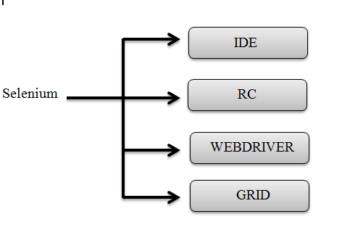
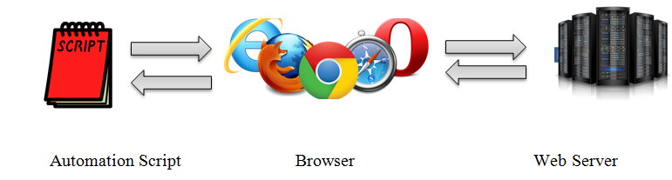
Features | UFT | IBM RIT | Selenium
Licence | Required | Required | Open Source
Cost | High | High | Less
Customer Support | Dedicated HP Support | Dedicated IBM Support | Open Source Community
Hardware Consumption during script execution | High | High | Low
Coding Experience | Not much | Required | Should be very good along with technical capabilities of integrating framework.
Environment Support | Only for windows | Only for windows | Any OS
Language Support | VB Script | Java and C# | Any PL

Slide 20
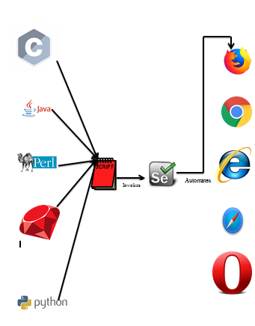
What Is Selenium WebDriver:-
Selenium WebDriver is a programming interface to create and execute test cases.
Test cases are created and executed using Element Locators/ Object Locators/ WebDriver methods.
Selenium WebDriver has only a programming interface; not IDE
Fast as it interact with directly browser.
Each browser has its own driver on which the application runs. Selenium webdriver makes direct calls to the browser.

Slide 21
Cucumber Framework :-
Cucumber is a testing tool that supports “Behaviour Driven Development (BDD)” framework. It defines application behaviour using simple English text, defined by a language called Gherkin.
Advantages Of Cucumber Framework :-
Cucumber supports different languages like Java.net and Ruby.
It acts as a bridge between the business and technical language. We can accomplish this by creating a test case in plain English text.
It allows the test script to be written without knowledge of any code, it allows the involvement of non-programmers as well.
It serves the purpose of end-to-end test framework unlike other tools.
Due to simple test script architecture, Cucumber provides code reusability.

Slide 22
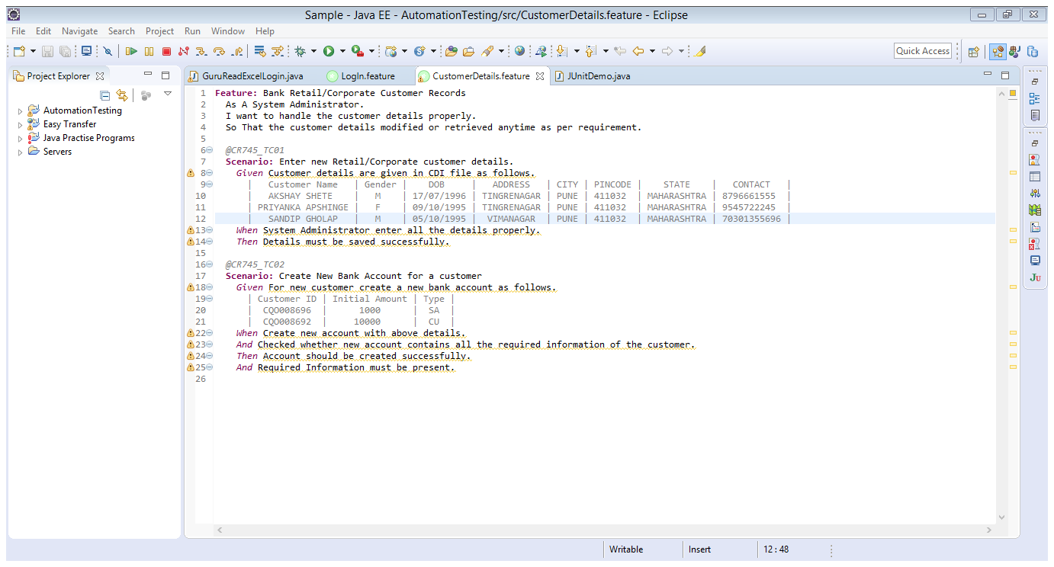

Slide 23
JUnit Framework (Automation Tool) :-
JUnit is a unit testing framework for Java programming language. It plays a crucial role test-driven development, and is a family of unit testing frameworks collectively known as JUnit.
Features of JUnit :-
JUnit is an open source framework, which is used for writing and running tests.
Provides annotations to identify test methods.
Provides assertions for testing expected results.
Provides test runners for running tests.
JUnit tests allow you to write codes faster, which increases quality.
JUnit is elegantly simple. It is less complex and takes less time.
JUnit tests can be run automatically and they check their own results and provide immediate feedback. There's no need to manually comb through a report of test results.
JUnit tests can be organized into test suites containing test cases and even other test suites.
JUnit shows test progress in a bar that is green if the test is running smoothly, and it turns red when a test fails.

Slide 24
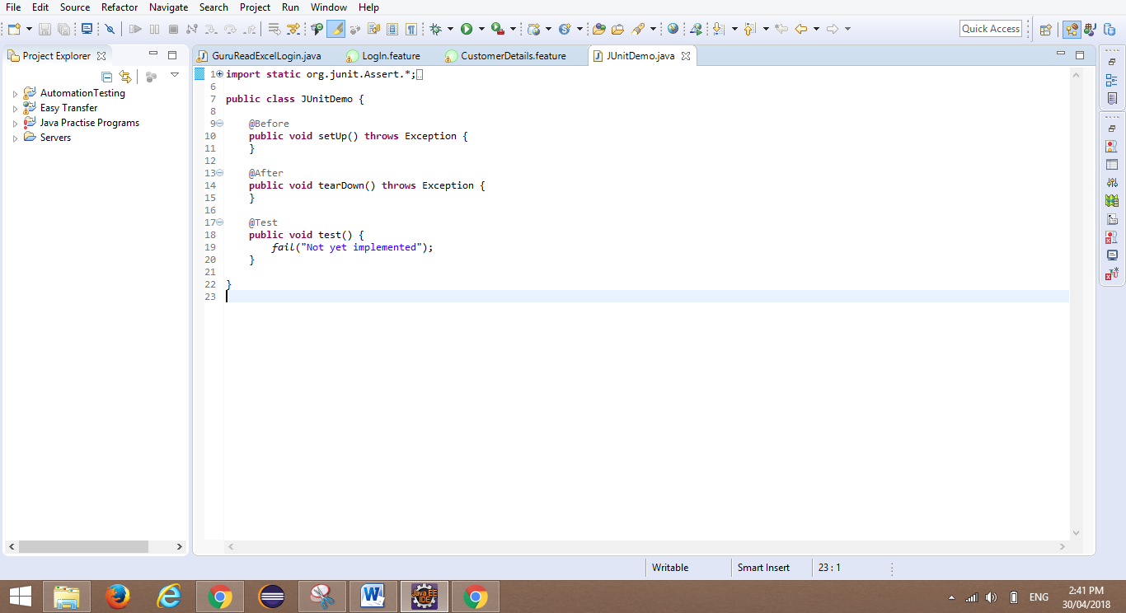
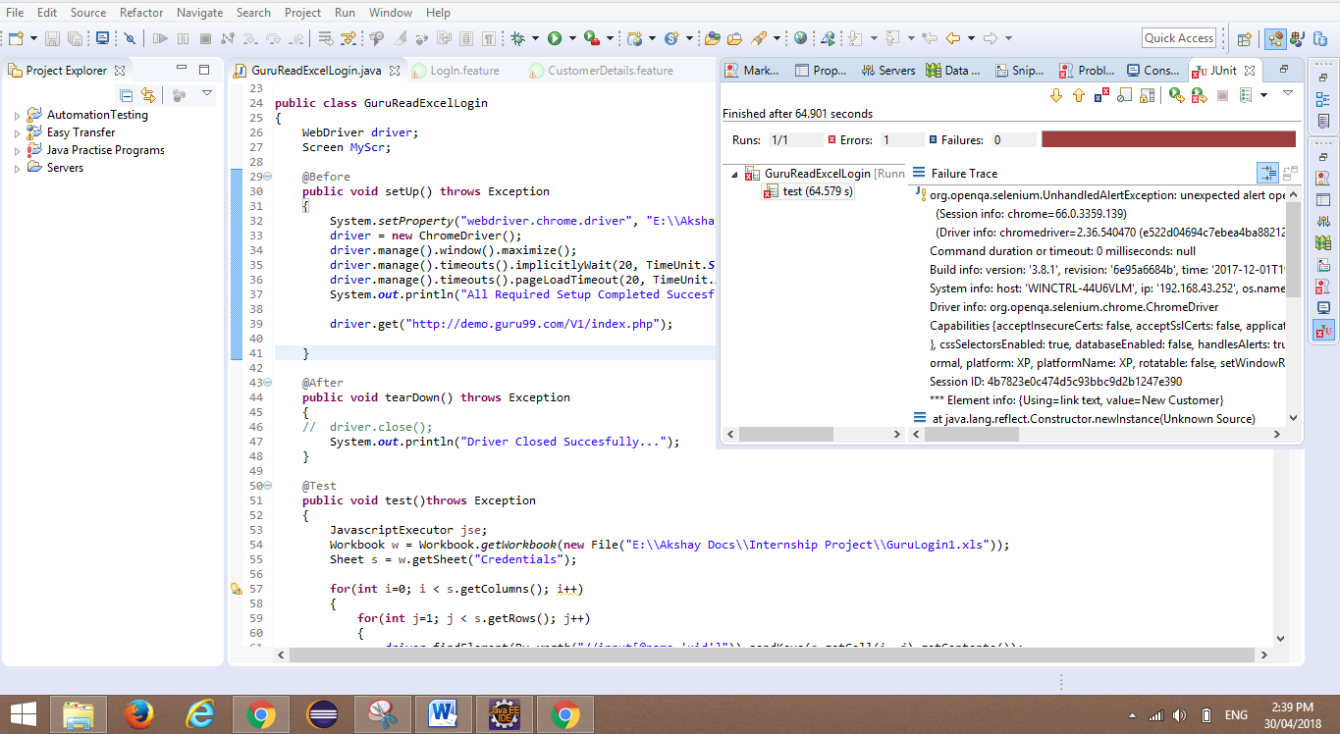
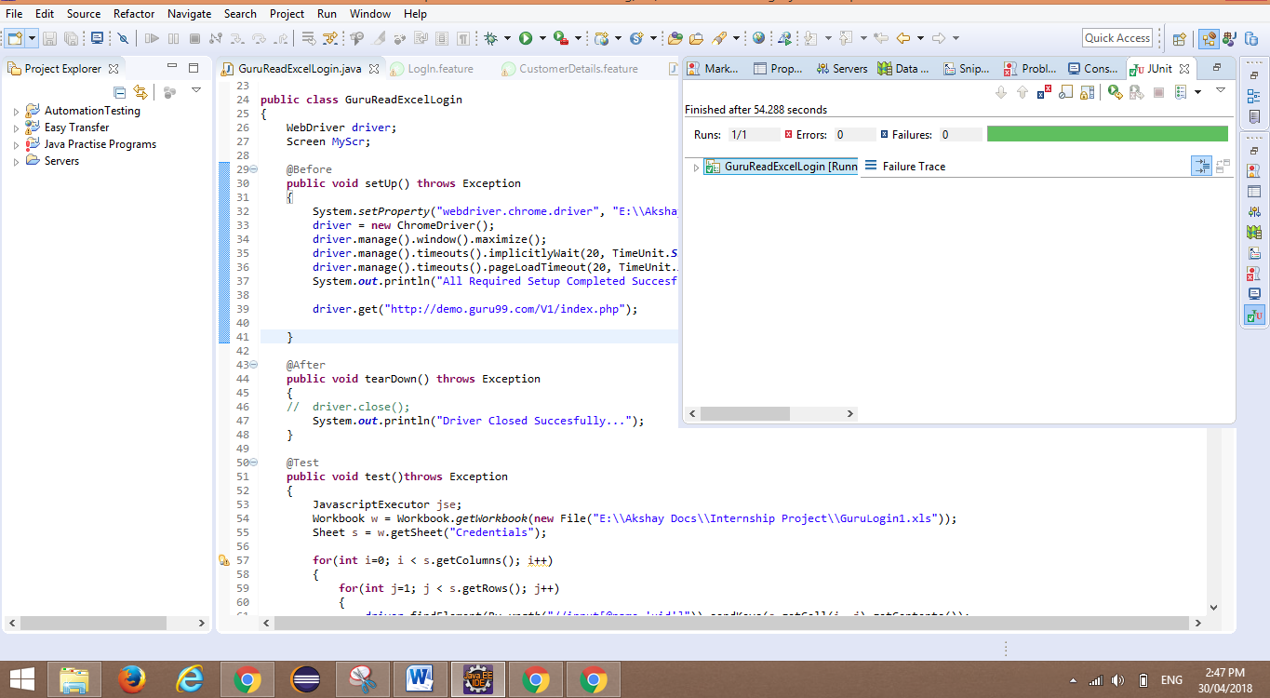
If our test script failed then JUnit Framework shows us respected error in detail with proper time script took for execution.
Basic JUnit Framework is looked like below :-
If our test script passed then JUnit Framework shows us only time taken by script for execution.

Slide 25
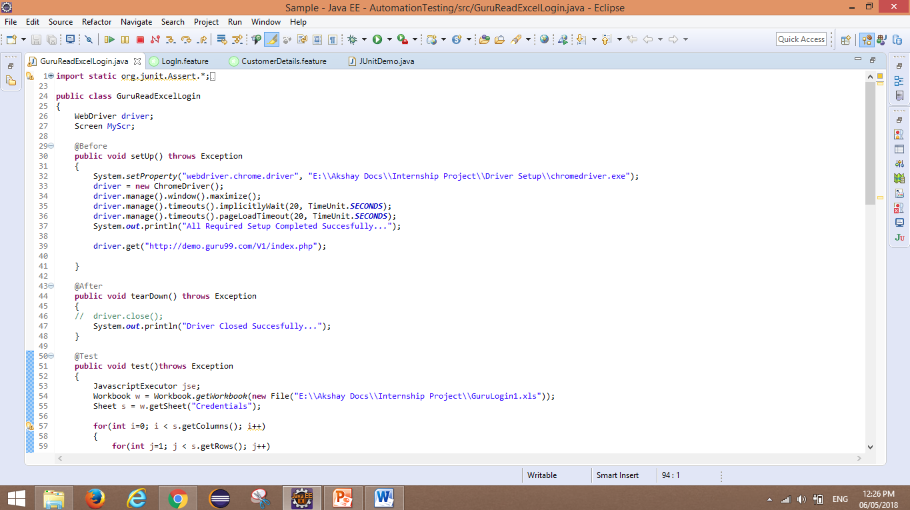
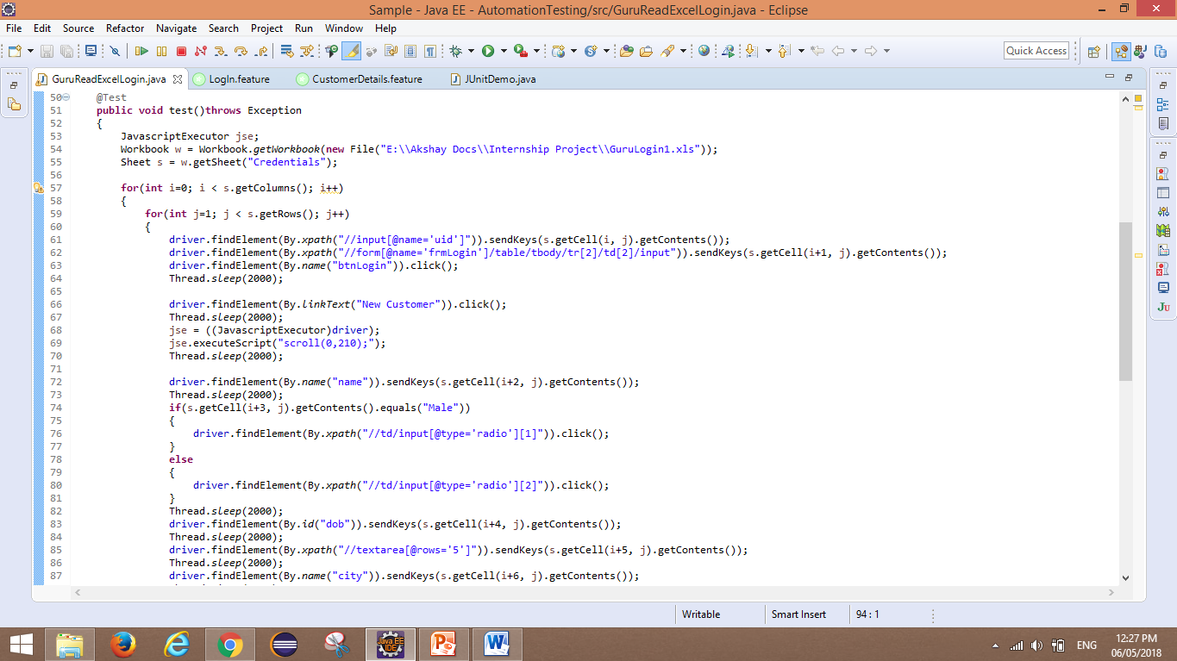
Code Snippet of Bank Product Testing :-
Written in Junit Framework.

Slide 26
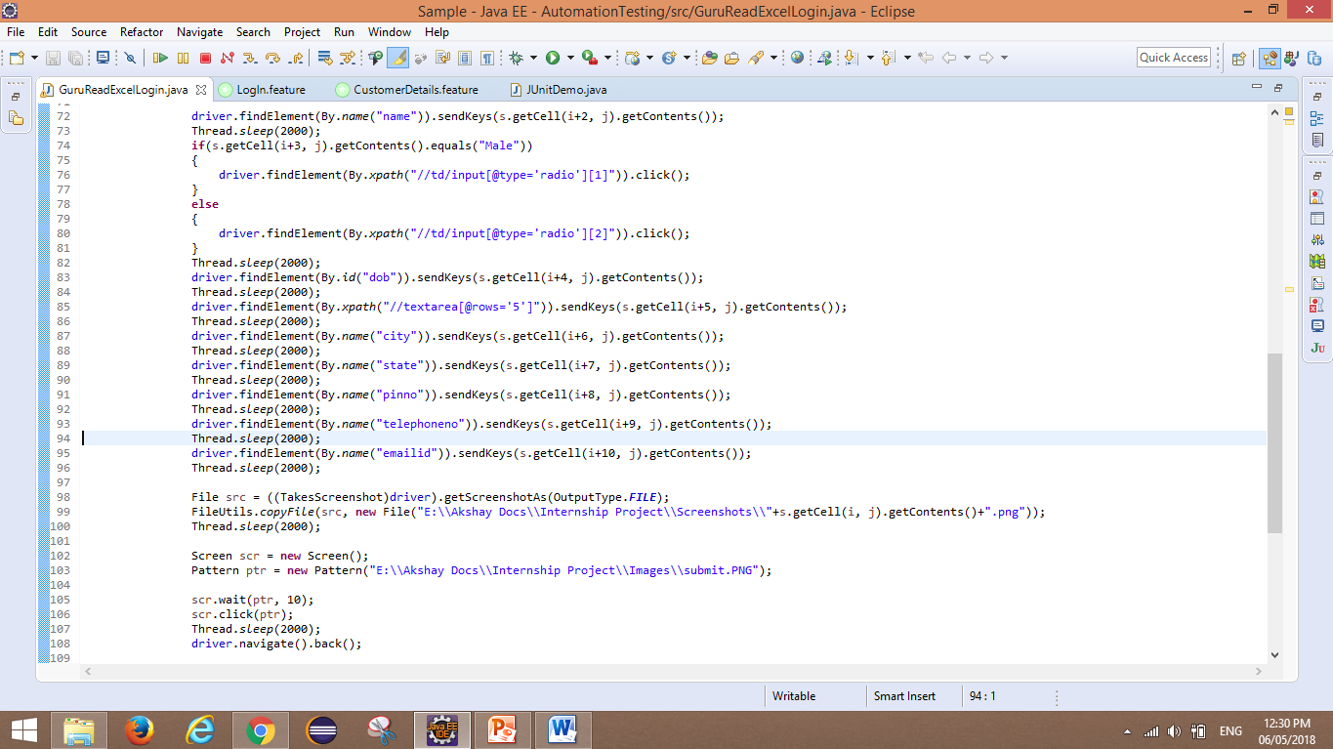
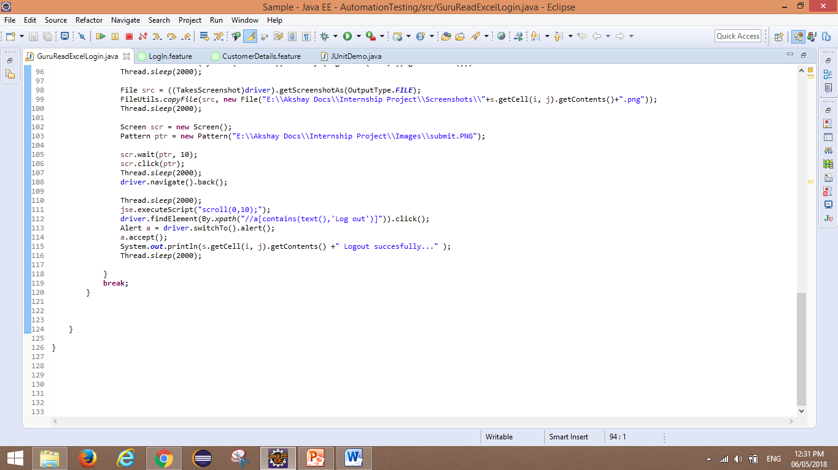

Using SIKULI Image Capture Tool:-
SIKULI Button:-

Slide 27
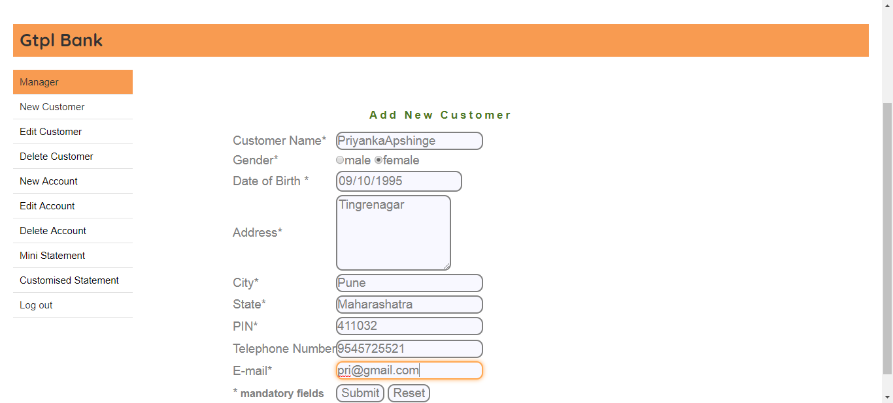


Read Data from Excel:-

Slide 28



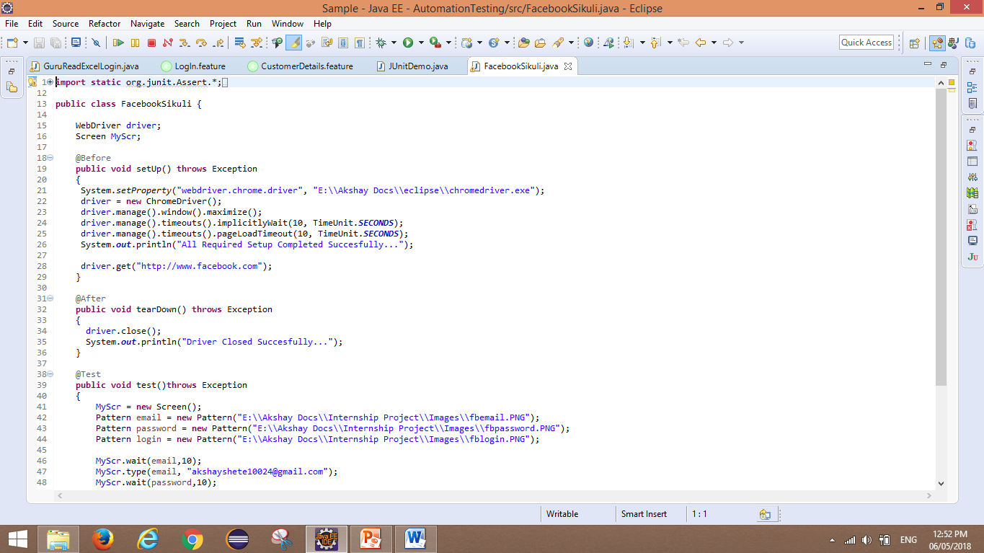
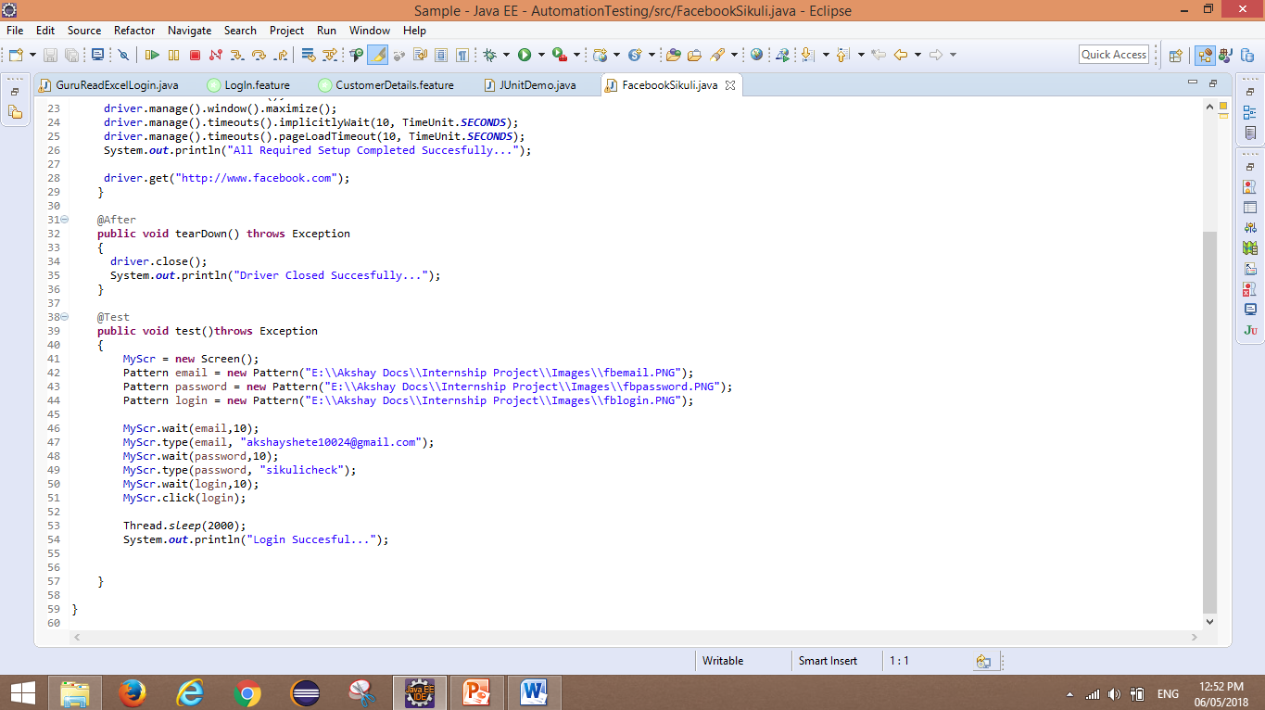
SIKULI Buttons:-
SIKULI is a Image Capturing Tool through which we can capture the element and use for further operations. Selenium doesn't have any image capturing property so this is third party tool we need to use while automating an application.

Slide 29
Requirement Traceability Matrix (RTM) :-
The Requirement Traceability Matrix (RTM) captures the complete user and system requirement for the system.
The RTM captures all requirements and their traceability in a single document.
Changes to the requirement are also recorded and tracked in the RTM.
The RTM is maintained throughout the lifecycle of the release, and it is reviewed at the end of release.
It is very useful document to track Time, Change, Risk Management in software testing.
It is of 3 types :- Forward Traceability, Backward Traceability, BI-Directional Traceability etc.

Slide 30
Thank You…

